Slide 1
Neural Network with Memory
Hung-yi Lee

Slide 2






Memory is important
$$x^{1}$$
$$x^{2}$$
$$x^{3}$$
1
1
Input:
2 dimensions
4
7
4
7
1
1
1 4 4
+
1 7 7
3
2
1
$${\hat{y}}^{1}$$
$${\hat{y}}^{2}$$
$${\hat{y}}^{3}$$
Output:
1 dimension
1
2
3
Network needs memory to achieve this
Notes:
Hard to learn by neural network

Slide 3






Memory is important
1
y
Network with Memory
-10
1
1
11
$$x^{1}$$
$$x^{2}$$
$$x^{3}$$
Memory
Cell
4
7
4
7
1
1
1
0
0
c₁
10
11
11
1
1
$${\hat{y}}^{1}$$
$${\hat{y}}^{2}$$
$${\hat{y}}^{3}$$
1
2
3
1
1
1
1
1
x₁
x₂
4
7
Notes:
Even the same input, the output may be different. due to the memory!

Slide 4
Memory is important
2
y
Network with Memory
-10
1
1
12
$$x^{1}$$
$$x^{2}$$
$$x^{3}$$
Memory
Cell
4
7
4
7
1
1
1
0
0
c₁
10
12
12
1
1
$${\hat{y}}^{1}$$
$${\hat{y}}^{2}$$
$${\hat{y}}^{3}$$
1
1
2
3
1
1
1
1
1
x₁
x₂
4
7

Slide 5
Memory is important
3
y
Network with Memory
-10
1
0
3
$$x^{1}$$
$$x^{2}$$
$$x^{3}$$
Memory
Cell
4
7
4
7
1
1
1
0
0
c₁
10
3
3
1
1
$${\hat{y}}^{1}$$
$${\hat{y}}^{2}$$
$${\hat{y}}^{3}$$
1
0
1
2
3
1
1
1
1
1
x₁
x₂
1
1

Slide 6
Outline
Vanilla Recurrent Neural Network (RNN)
Long Short-term Memory (LSTM)
Variants of RNN

Slide 7
Outline
Vanilla Recurrent Neural Network (RNN)
Long Short-term Memory (LSTM)
Variants of RNN

Slide 8

Application
(Simplified) Speech Recognition
y¹
y²
y³
y¹
y²
y³
y⁴
……
y⁴
……
TSI
TSI
TSI
I
I
N
N
N
S
S
@
@
@
@
x¹
x²
x³
x⁴
……
x¹
x²
x³
x⁴
……
Utterance 1
Utterance 2
We use DNN. All the frames are considered independently.
Notes:
沒有考慮

Slide 9
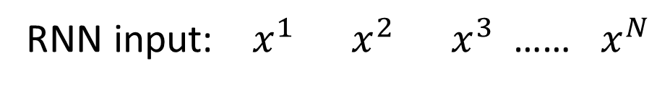
RNN
The order cannot change.
Input of RNN is one utterance
RNN input: $x^{1} x^{2} x^{3}$…… $x^{N}$
y¹
y¹=softmax(Wºa¹)
copy
Wº
a¹=σ(W^{i}x¹+W^{h}0)
memory
0
a¹
W^{h}
W^{i}
x¹
Notes:
(frames in an utterance)
Output y^{i} depends on x^{i} and memory

Slide 10
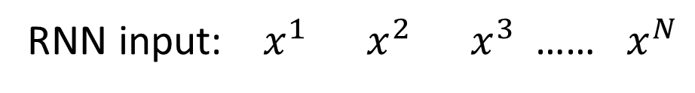
RNN
The order cannot change.
Input of RNN is one utterance
RNN input: $x^{1} x^{2} x^{3}$…… $x^{N}$
y¹
y²
y²=softmax(Wºa²)
copy
Wº
a²=σ(W^{i}x²+W^{h}a¹)
memory
0
a¹
a²
W^{h}
W^{i}
x²
Notes:
(frames in an utterance)

Slide 11
RNN
The order cannot change.
Input of RNN is one utterance
RNN input: $x^{1} x^{2} x^{3}$…… $x^{N}$
y¹
y²
y³
y³=softmax(Wºa³)
copy
Wº
a³=σ(W^{i}x³+W^{h}a²)
memory
0
a¹
a²
a³
W^{h}
W^{i}
x³
Notes:
(frames in an utterance)

Slide 12
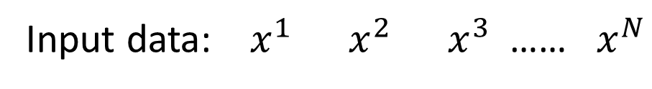
RNN
Input of RNN is one utterance
Input data: $x^{1} x^{2} x^{3}$…… $x^{N}$
y¹
y²
y³
init
Wº
copy
Wº
copy
Wº
a¹
a²
a³
0
a¹
a²
W^{h}
W^{h}
W^{h}
W^{i}
W^{i}
W^{i}
x¹
x²
x³
The same network is used again and again.
Output y^{i} depends on x¹, x², …… x^{i}
Notes:
General idea

Slide 13
RNN
Input of RNN is one utterance
Input data: $x^{1} x^{2} x^{3}$…… $x^{N}$
y¹
y²
y³
Wº
Wº
Wº
init
W^{h}
W^{h}
W^{h}
……
0
W^{i}
W^{i}
W^{i}
x¹
x²
x³
The same network is used again and again.
Output y^{i} depends on x¹, x², …… x^{i}
Notes:
General idea

Slide 14
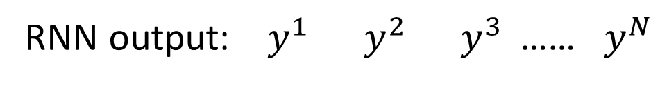
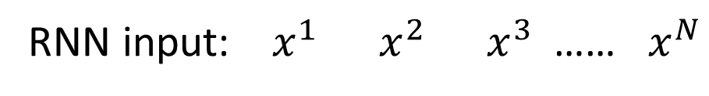
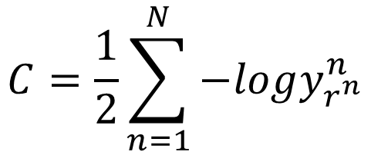
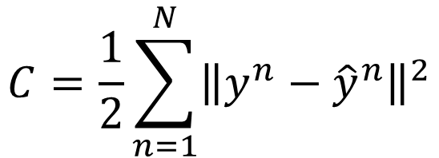
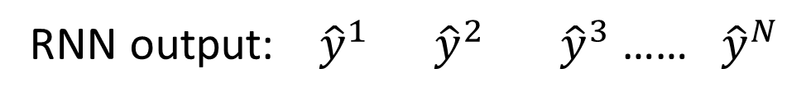
Cost
RNN input: $x^{1} x^{2} x^{3}$…… $x^{N}$
RNN output: $y^{1} y^{2} y^{3}$…… $y^{N}$
RNN output: ${\hat{y}}^{1} {\hat{y}}^{2} {\hat{y}}^{3}$ …… ${\hat{y}}^{N}$
$$C=\frac{1}{2}\sum_{n=1}^{N}{{\left\|y^{n}−{\hat{y}}^{n}\right\|}^{2}}$$
$$C=\frac{1}{2}\sum_{n=1}^{N}{−logy_{r^{n}}^{n}}$$

Slide 15



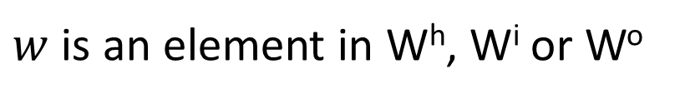

Training
$${\hat{y}}^{1}$$
$${\hat{y}}^{2}$$
$${\hat{y}}^{3}$$
y¹
y²
y³
Wº
Wº
Wº
init
W^{h}
W^{h}
W^{h}
……
0
W^{i}
W^{i}
W^{i}
x¹
x²
x³
$w$ is an element in W^{h}, W^{i} or Wº
$$w←w−η∂C∕∂w$$
Backpropagation through time (BPTT)
RNN Training is very difficult in practice.

Slide 16
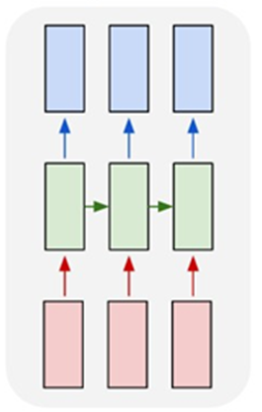
More Applications
Input and output are vector sequences with the same length
y¹
y²
y³
y¹
y²
y³
y⁴
PN V D N
x¹
x²
x³
x⁴
John saw the saw.
x¹
x²
x³
POS Tagging

Slide 17
More Applications
Name entity recognition
Identifying names of people, places, organizations, etc. from a sentence
Harry Potter is a student of Hogwarts and lived on Privet Drive.
people, organizations, places, not a name entity
Information extraction
Extract pieces of information relevant to a specific application, e.g. flight booking
I would like to leave Boston on November 2nd and arrive in Taipei before 2 p.m.
place of departure, destination, time of departure, time of arrival, other
Notes:
named entity tagging - 專有名詞標記

Slide 18
Outline
Vanilla Recurrent Neural Network (RNN)
Long Short-term Memory (LSTM)
Variants of RNN

Slide 19
Elman Network & Jordan Network
Elman Network
Jordan Network
y^{t}
y^{t+1}
y^{t}
y^{t+1}
W^{h}
Wº
Wº
Wº
Wº
……
……
……
……
W^{h}
W^{i}
W^{i}
W^{i}
W^{i}
x^{t}
x^{t+1}
x^{t}
x^{t+1}

Slide 20
Deep RNN
y^{t}
y^{t+1}
y^{t+2}
……
……
……
……
……
……
……
……
……
x^{t}
x^{t+1}
x^{t+2}

Slide 21
Bidirectional RNN
……
x^{t}
x^{t+1}
x^{t+2}
……
y^{t}
y^{t+1}
y^{t+2}
……
……
x^{t}
x^{t+1}
x^{t+2}
Notes:
To determine yi, you have to consider a lot ……
There are more different types in the slides of HW3.

Slide 22
Many to one
Input is a vector sequence, but output is only one vector
Sentiment Analysis
超好雷
好雷
看了這部電影覺得很高興 …….
這部電影太糟了
…….
這部電影很棒 …….
普雷
負雷
Positive (正雷)
Negative (負雷)
Positive (正雷)
超負雷
……
我
覺
得
……
太
糟
了
Notes:
Emotiona regonition

Slide 23
Many to Many (Output is shorter)
Both input and output are vector sequences, but the output is shorter.
好
好
好
棒
棒
棒
棒
棒
x¹
x²
x³
x⁴
……
Trimming
“好棒”
You can never recognize “好棒棒” !
Speech Recognition

Slide 24
Many to Many (Output is shorter)
Both input and output are vector sequences, but the output is shorter.
Connectionist Temporal Classification (CTC)
Add an extra symbol “φ” (同上)
好
φ
φ
棒
φ
φ
φ
φ
“好棒”
好
φ
φ
棒
φ
棒
φ
φ
“好棒棒”

Slide 25
Many to Many (No Limitation)
Both input and output are vector sequences with different lengths. → Sequence to sequence learning
機
器
學
習
慣
性
……
……
never-ending
machine
learning
Machine Translation
Notes:
2nd of a completition

Slide 26
Many to Many (No Limitation)
推文接龍
Ref: http://pttpedia.pixnet.net/blog/post/168133002-%E6%8E%A5%E9%BE%8D%E6%8E%A8%E6%96%87
推xxx: ptt萬歲
推dd: 歲平安
噓dddf: 全
推zzzzzzzzzzz: 家就是你家
……
推tlkagk: =========斷==========

Slide 27
Many to Many (No Limitation)
Both input and output are vector sequences with different lengths. → Sequence to sequence learning
機
器
學
習
===
Add a symbol “===“ (斷)
machine
learning
Notes:
2nd of a completition

Slide 28

One to Many
Input is one vector, but output is a vector sequence
(斷)
a
woman
is
throwing
……
a
===
……
Input
Caption generation
Notes:
A woman is throwing a Frisbee in a part.

Slide 29
Outline
Vanilla Recurrent Neural Network (RNN)
Long Short-term Memory (LSTM)
Variants of RNN
Notes:
Long-term Memory why why why

Slide 30
Long Short-term Memory (LSTM)
Other part of the network
Special Neuron:
4 inputs,
1 output
Signal control the output gate
Output Gate
(Other part of the network)
Memory
Cell
Forget Gate
Signal control the forget gate
(Other part of the network)
Signal control the input gate
Input Gate
LSTM
(Other part of the network)
Other part of the network
Notes:
Normal neuron
1 input, 1 output
This one
4 input, 1 output

Slide 31
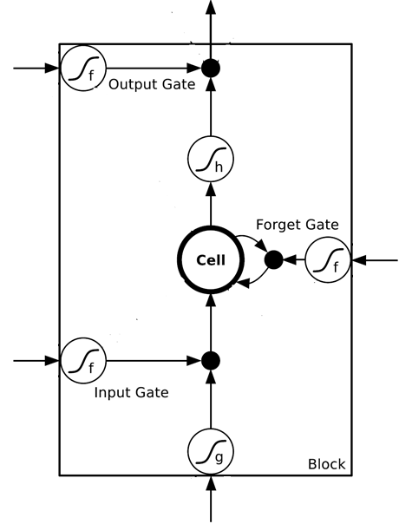
















$$a$$
$$=h\left(c^{′}\right)f\left(z_{o}\right)$$
$$z_{o}$$
multiply
Activation function f is usually a sigmoid function
$$f\left(z_{o}\right)$$
$$h\left(c^{′}\right)$$
Between 0 and 1
Mimic open and close gate
$$c$$
$$f\left(z_{f}\right)$$
c
$$c^{′}$$
$$z_{f}$$
$$cf\left(z_{f}\right)$$
$$c^{′}=g\left(z\right)f\left(z_{i}\right)+cf\left(z_{f}\right)$$
$$f\left(z_{i}\right)$$
$$g\left(z\right)f\left(z_{i}\right)$$
$$z_{i}$$
multiply
$$g\left(z\right)$$
$$z$$

Slide 32




Original Network:
Simply replace the neurons with LSTM
……
……
$$a_{1}$$
$$a_{2}$$
$$z_{1}$$
$$z_{2}$$
x₁
x₂
Input
Notes:
Use a same set of information
Note about the memory

Slide 33


$$a_{1}$$
$$a_{2}$$
+
+
+
+
+
+
+
+
4 times of parameters
x₁
x₂
Input
Notes:
Use a same set of information
Note about the memory

Slide 34




LSTM - Example
0
0
3
3
7
7
7
0
6
$$x_{1}$$
1
0
0
3
1
0
2
0
0
4
1
0
2
0
0
1
0
1
3
-1
0
6
1
0
1
0
1
$$x_{2}$$
$$x_{3}$$
$$y$$
0
0
0
0
0
7
0
0
6
When x₂ = 1, add the numbers of x₁ into the memory
When x₂ = -1, reset the memory
When x₃ = 1, output the number in the memory.
Notes:
Can you find the rule?

Slide 35




x₁
0
y
$$y$$
0
0
0
7
0
x₂
0
+
x₃
100
0
x₁
1
-10
100
0
0
+
x₂
x₁
0
x₃
x₂
100
+
10
1
x₃
0
1
-10
+
$$x_{1}$$
3
1
0
4
1
0
2
0
0
1
0
1
3
-1
0
1
0
0
0
$$x_{2}$$
x₁
x₂
x₃
1
$$x_{3}$$
Notes:
Look at the sequence first

Slide 36
3
0
≈0
y
$$y$$
0
0
0
7
0
1
0
+
≈0
3
0
100
0
3
1
-10
0
100
0
3
+
1
3
≈1
0
0
100
≈1
3
1
+
10
1
3
0
0
1
-10
+
$$x_{1}$$
3
1
0
4
1
0
2
0
0
1
0
1
3
-1
0
1
0
0
0
$$x_{2}$$
3
1
0
1
$$x_{3}$$

Slide 37
4
0
≈0
y
$$y$$
0
0
0
7
0
1
0
+
≈0
7
0
100
0
4
1
-10
7
100
0
3
+
1
4
≈1
0
0
100
≈1
4
1
+
10
1
4
0
0
1
-10
+
$$x_{1}$$
3
1
0
4
1
0
2
0
0
1
0
1
3
-1
0
1
0
0
0
$$x_{2}$$
4
1
0
1
$$x_{3}$$

Slide 38
2
0
≈0
y
$$y$$
0
0
0
7
0
0
0
+
≈0
7
0
100
0
2
1
-10
7
100
0
+
0
2
≈1
0
0
100
≈0
0
0
+
10
1
2
0
0
1
-10
+
$$x_{1}$$
3
1
0
4
1
0
2
0
0
1
0
1
3
-1
0
1
0
0
0
$$x_{2}$$
2
0
0
1
$$x_{3}$$

Slide 39
1
0
≈7
y
$$y$$
0
0
0
7
0
0
0
+
≈1
7
1
100
0
1
1
-10
7
100
0
+
0
1
≈1
0
1
100
≈0
0
0
+
10
1
1
1
0
1
-10
+
$$x_{1}$$
3
1
0
4
1
0
2
0
0
1
0
1
3
-1
0
1
0
0
0
$$x_{2}$$
1
0
1
1
$$x_{3}$$

Slide 40
3
0
≈0
y
$$y$$
0
0
0
7
0
-1
0
+
≈0
0
0
100
0
3
1
-10
0
100
0
7
+
-1
3
≈0
0
0
100
≈0
0
-1
+
10
1
3
0
0
1
-10
+
$$x_{1}$$
3
1
0
4
1
0
2
0
0
1
0
1
3
-1
0
1
0
0
0
$$x_{2}$$
3
-1
0
1
$$x_{3}$$

Slide 41
What is the next wave?
Attention-based Model
……
……
Memory
Reading Head
Writing Head
Reading Head Controller
Writing Head Controller
Input x
DNN
output y
Notes:
Need an example …… ok, in the future

Slide 42
Recommended Reading List
The Unreasonable Effectiveness of Recurrent Neural Networks
http://karpathy.github.io/2015/05/21/rnn-effectiveness/
Understanding LSTM Networks
http://colah.github.io/posts/2015-08-Understanding-LSTMs/

Slide 43
Acknowledgement
感謝 葉軒銘 同學於上課時發現投影片上的錯誤

